Slide 1
DRIVER ALERTNESS DETECTION
PIP2001 Capstone Project
Review-0
Batch Number : CDV-5
Under the Supervision of,
Mr. RAJAN THANGAMANI
Assistant Professor
School of Computer Science and Engineering
Presidency University
Roll Number | Student Name
20211CDV0053 | HARISH BHASKARAN
20211CDV0068 | RUTHWICK S S
20211CDV0018 | RAGHAVENDRA RAKESH
20211CDV0065 | KAVANA S K
Name of the Program: B.TECH COMPUTER SCIENCE AND TECHNOLOGY [DEVOPS]
Name of the HoD: Dr. S PRAVINTHRAJA
Name of the Program Project Coordinator: SUMA N G
Name of the School Project Coordinators: Dr. Sampath A K / Dr. Abdul Khadar A / Mr. Md Ziaur Rahman

Slide 2

Content
Problem Statement
Github Link
Analysis of Problem Statement
Timeline of the Project
References

Slide 3
Problem Statement Number: PSCS204
Organization: MindTree
Category (Hardware / Software / Both) : BOTH
Problem Description: The objective of driver alertness detection is to develop a system capable of accurately detecting and monitoring driver alertness levels to enhance road safety and reduce the incidence of accidents caused by drowsy or distracted driving.
Difficulty Level: Simple

Slide 4

Github Link
Driver Alertness Detection

Slide 5
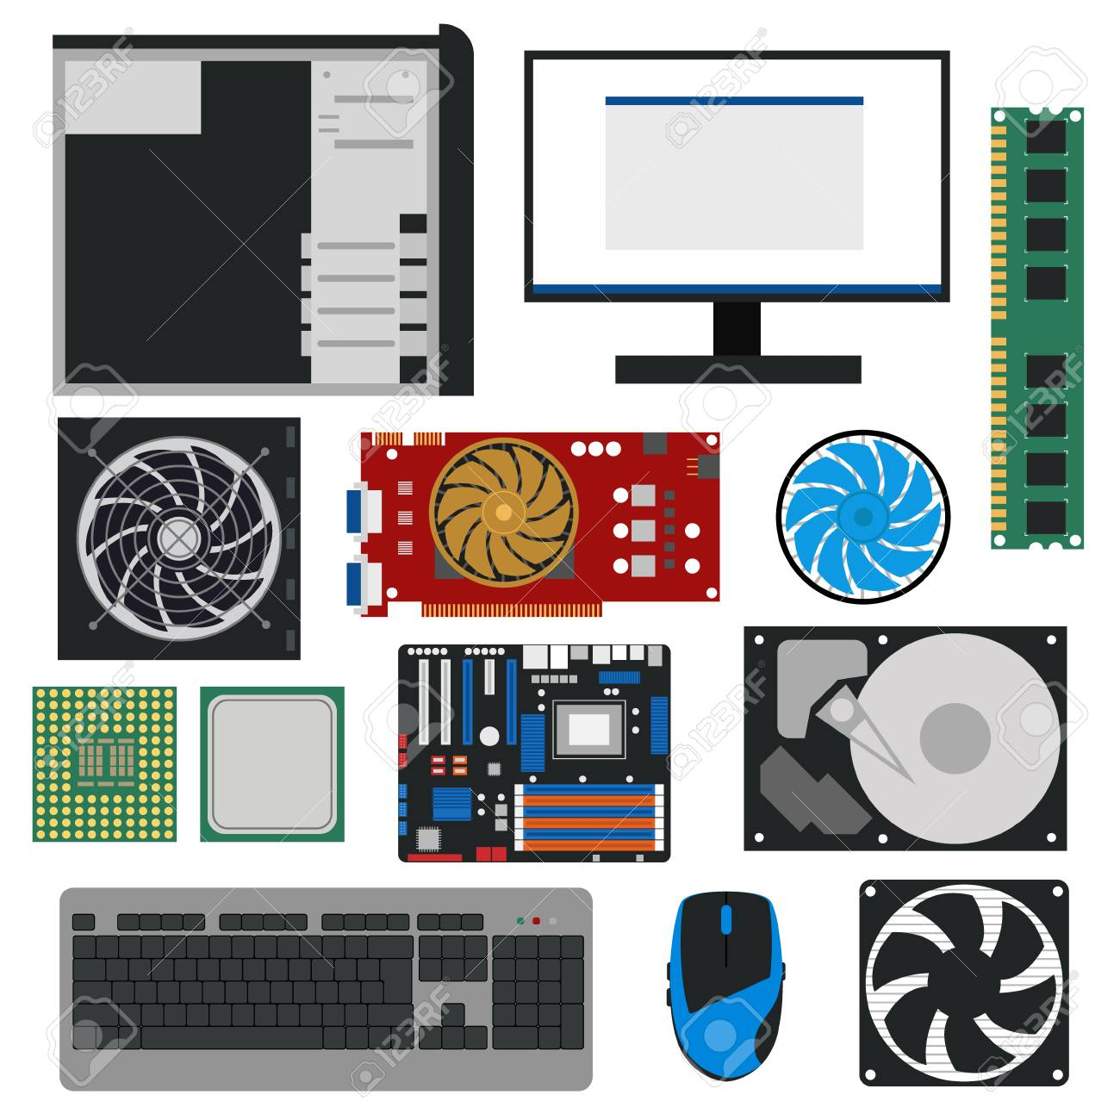
Analysis of Problem Statement
Hardware Components:
Raspberry Pi 4 Model B
Alcohol Sensor
Camera
Buzzer
Speaker
Cables and connectors
LCD monitor

Slide 6
Analysis of Problem Statement (contd...)
Software Requirements:
Visual Studio Code
VNC Viewer
Python 3
OpenCV - Face and eye detection
Imutils - To get landmarks of eye
Scipy - To calculate the distance between eye landmarks
Dlib - To detect faces in photos and videos

Slide 7
Analysis of Problem Statement (contd...)
Steps involved:
Initialize the system.
Start the data collection process.
Capture a facial image using the camera module.
Apply image processing techniques to extract relevant features from the facial image.
Check the alcohol detection.
Analyze the extracted facial features.
Classify the individual's state as either drowsy or alert based on the analysis of drowsiness features.
If drowsiness or high alcohol levels are detected: Activate the buzzer and speaker to generate audio warnings or alerts.
Repeat the process by capturing new facial images and continuously monitoring the individual's state.
Terminate the system.

Slide 8
Timeline of the Project (Gantt Chart)
Review 0
Review 3
Review 4
Review 2
Review 1
Analysing the project and gathering information about required components

Slide 9
References
[1]Rhody Chester, H. F. ‘’Hough Circle Transform‘’, CarlsonCenter for ImagingScience Rochester Institute of Technology October 11, 2005
[2]Mario I Chacon-Murguia Claudia Prieto-Resendiz,”Detecting Driver Drowsiness-A survey of system designs and technology,” IEEE Consumer Electronics Magazine,pp.107-108, October 2015.
[3]Mayank Chauhan, Mukesh Sakle”Study & Analysis of Different Face Detection Techniqes” International Journal of Computer Science and Information Technologies, Vol. 5 (2) , pp 1615-1618,2014.
[4]Paul Viola and Michael j. Jones,” Rapid Object Detection using a Boosted Cascade of Simple Features,” International Journal of Computer Vision 57(2), pp 137–154, 2001.
[5]Paul Viola and Michael j. Jones,” Robust Real-Time Face Detection,” International Journal of Computer Vision 57(2), 137–154, 2004.

Slide 10


